Slide 1
CS3220 Processor Design
Prof. Hyesoon Kim

Slide 2
Intermediate wire
module simple_in_n_out ( in_1, in_2,in_3, out_1);
input in_1;
input in_2;
input in_3;
output out_1;
assign out1_ = (in1&in_2) |in3;
endmodule
In_1
In_2
Out_1
In_3

Slide 3
Intermediate wire
module simple_in_n_out ( in_1, in_2,in_3, out_1);
input in_1;
input in_2;
input in_3;
output out_1;
wire intermediate_sig;
assign intermediate_sig = in1&in_2;
assign out_1 = intermediate_sig & in3;
endmodule
intermediate_sig
In_1
In_2
Out_1
In_3
From: Verilog by example (Readler)

Slide 4
Testing and Simulation

Slide 5
Testing myxor
Testing requires another module/another Verilog coding
module my_test;
reg a,b;
wire c;
localparam period=20;
myxor myxor1(.c(c), .a(a), .b(b));
initial
begin
a = 0;
b = 0;
#period;
a = 0;
b = 1;
#period;
end

Slide 6
Conditional Statements
if and else are used for conditional statements
if (<expression>) true_statement;
if (<expression> true_statement; else false_statement;
if (<expression>) true_statement1;
else if (<expression>) true_statement2;
else default_statement;
Case statement
case (expression)
alternative1: statement1;
alterantive2: statement2;
alternative3: statement3;
…
default: default_statement;
endcase

Slide 7
Lab DAY #2 Contents

Slide 8
Bus Signals
module bus_sigs ( in_1, in_2,in_3, out_1);
input [3:0] in_1;
input [3:0] in_2;
input in_3;
output [3:0] out_1;
wire [3:0] in_3_bus;
assign in_3_bus = {4{in_3}};
assign out_1 = (in_1 & in_2 ) | ~in_3_bus;
endmodule
In_3 is replicated 4 times
From: Verilog by example (Readler)

Slide 9
Bus Breakout
Concatenation
BUS = {out_1, out_2};
BUS_2 = {BUS[3:0], out[2:0]};

Slide 10
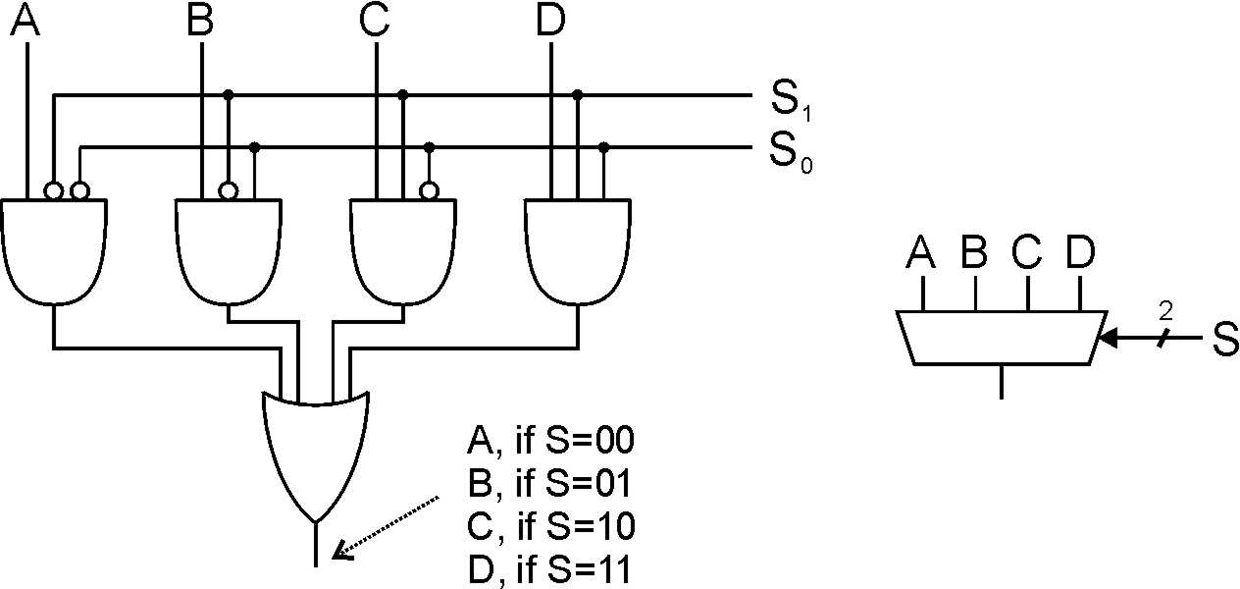
MUX examples
wire A, B, C, D;
reg out;
wire out1, out2, out3, out4;
wire[1:0] sel;
assign out1 = A & ! sel[1] & !sel[0];
assign out2 = B & ! sel[1] & sel[0];
assign out3 = C & sel[1] & !sel[0];
assign out4 = D & sel[1] & sel[0];
assign out = out1 | out 2| out3 | out 4;

Slide 11
Verilog description of MUX
wire A, B, C, D;
reg out;
wire [1:0] sel;
assign out = (sel==2’b00) ? A : 1’bz,
out = (sel==2’b01) ? B : 1’bz,
out = (sel==2’b10) ? C : 1’bz,
out = (sel==2’b11) ? D : 1’b z;

Slide 12
Verilog description of MUX
wire A, B, C, D;
reg out;
wire [1:0] sel;
always @(A or B or C or D or sel)
case (sel)
2’b00: out = A;
2’b01: out = B;
2’b10: out = C;
2’b11: out = D;
default: out = 1’bz;

Slide 13
Vectors vs. Arrays
Vectors
To define multiple width wires or registers
Definition:
Wire/reg[msb_index: lsb_index] <data_id>;
Arrays
It is possible to have reg, integer and time arrays
Definition:
<data_type> <var_name> [start_idx : end_idx]
https://cs.uwaterloo.ca/~oardakan/files/Verilog-Intro.pdf

Slide 14
n-bit signals
Multi-bit signals
2-to-1 multiplexer with 8-bit operands
module mux_2_to_1 (a,b, out, outbar, sel);
input[7:0] a,b;
input sel;
output[7:0] out, outbar;
reg[7:0] out;
always @(a or b or sel)
begin
if (sel) out = a;
else out = b;
end
assign outbar ~=out;
endmodule
a
8
8
8
out
b
outbar
8
sel
http://web.mit.edu/6.111/www/f2007/handouts/L04.pdf

Slide 15
State Machines

Slide 16
Sequential Circuits
state
Combinational Logic
in
out
Output of sequential circuits depends not only the current state but also the history of the previous state

Slide 17
Synchronous Sequential Circuits
Synchronized to a clock signal
: finite-state machine (FSMs)
state
Combinational Logic
D Q
in
out
clk

Slide 18
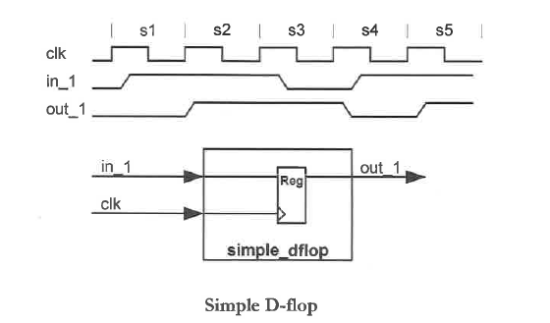
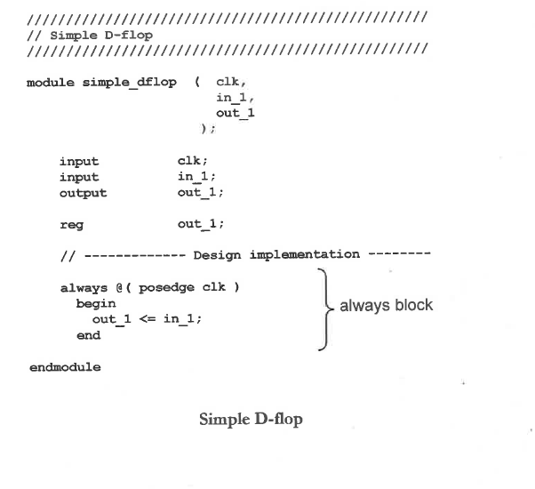
Simple D-flop
From Verilog by example book (Readler)

Slide 19
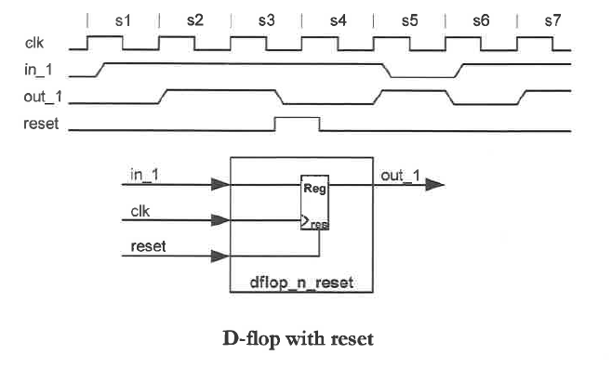
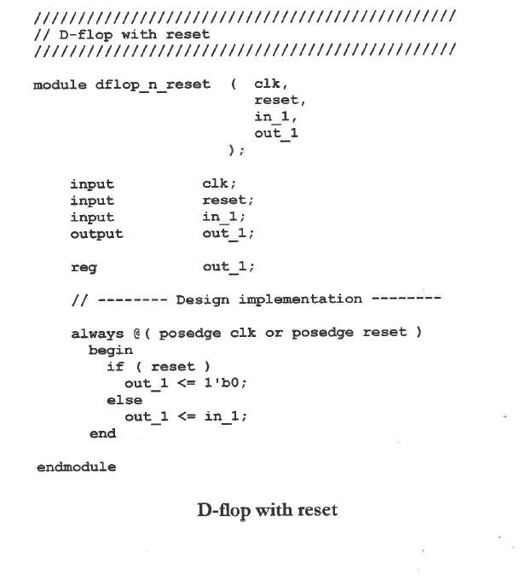
D-flop with reset
From Verilog by example book (Readler)

Slide 20
Blocking vs. Nonblocking Assignment
Blocking assignments: executed in the order they are specified in a sequential block
Nonblocking assignments: (<=) assignments allow scheduling without blocking execution of the statements that follow in a sequential block
reg a, b;
initial
begin
a = state1;
b = state2;
end
reg a, b;
initial
begin
a <= state1;
b <= state2;
end

Slide 21
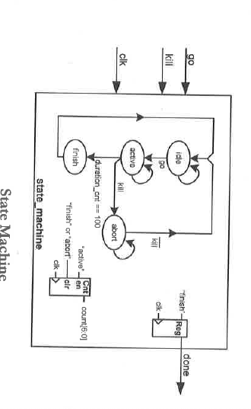
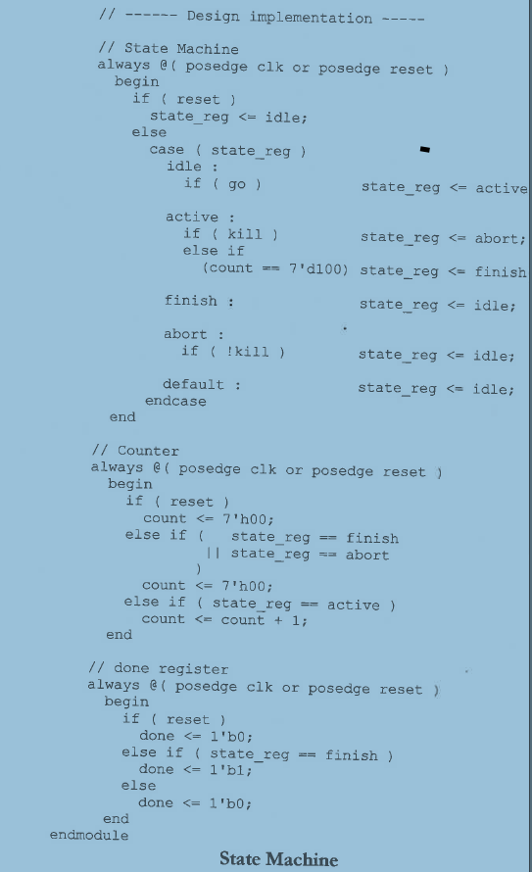
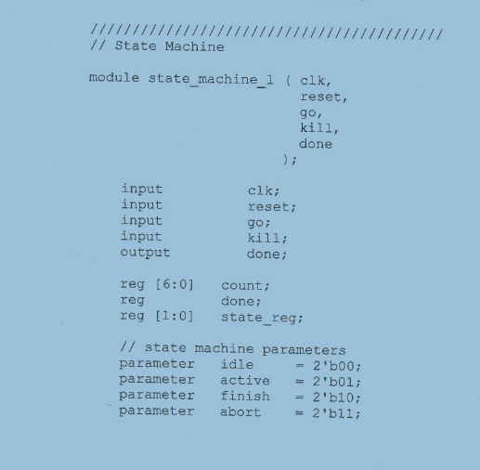
State Machine
From Verilog by example book (Readler)

Slide 22
General rules for always
always @(*)
Combinational logic
always @(clock)
Put latch events
Inside always : please put only logics.
Don’t declare wire,regs
Don’t instantiate a module inside always block.
CS3220 Prof. Milos Prvulovic

Slide 23
Note:
Don’t put
“output<= “ in multiple always statements
Why not?
Not synthesizable: Compiler can or cannot generate combinational logic circuits from verilog code
always @(posedge clk) begin
if (cond1)
count <= ….
end
always @(posedge clk)
begin
If (cond2)
count <= …
end
always @(posedge clk) begin
if (cond1)
count <= ….
else if (cond2)
count <= …
end
+
count should be a ”reg” type
count cannot be “wire” type

Slide 24
Memory

Slide 25
Memories in Verilog
reg [15:0] mem[0:1023]. → reg [15:0] mem[1023:0] are the same.
Data width
Now, let’s just think memory is a group of registers.
This is not really true but let’s just do that for now.
Total size of memory = 16b x 2^1024 → 2KB
Size of memory

Slide 26
How to initialize Memory Values?
This is an option to use for behavior simulation
reg [15:0] dmem[0:1023]
initial begin
$readmemh("ex1.mem", dmem);
end

Slide 27
Synchronous read vs. Asynchronous read
Synchronous (clocked) read
always @(posedge clock) begin
mdr <= dmem[mar]; // Read memory
end
Asynchronous read
assign read_data = dmem[mar];

Slide 28
Defining Memory in FPGA
(1) Infer the memory directly via the Verilog code
(2) Build the memory using the vendor’s primitive RAM structures
(3) Design the memory using the FPGA vendor’s specialized tools
From:Verilog by example Blaine C. Readler

Slide 29
Inference vs. Instantiation
Verilog can use “inference” or “instantiation” memory
Inference in synthesis: portable coding style, automatic timing-driven synthesis,
Instantiation: efficient use of the FPGA based on the specific technology, supports all kinds of RAM
We use “inference” method
From:http://www.ee.hacettepe.edu.tr/~alkar/ELE432/ECE432_memory_5.pdf

